Slide 1



SafeSlinger
Easy-to-Use and Secure Public-Key Exchange
Michael Farb (CMU), Yue-Hsun Lin (CMU), Tiffany Hyun-Jin Kim (CMU), Jonathan McCune (Google), Adrian Perrig (CMU/ETH)
Notes:
Describe the name, purpose (goal)
Describe the coworkers

Slide 2

Setting: Key Distribution in Groups
Exchange information to secure communications
Cryptographic Keys
People meet & want to communicate securely later
Researchers at a conference
Business people at a lunch
Challenge: No commonly trusted infrastructure
Notes:
Key distribution is fundamental problem.
We have many useful protocols such as SSL for entities that already share authentic key material,
but the root of the problem still remains: how do we obtain the authentic public key from the intended individual?

Slide 3
Prior Solutions
PKI (Public-Key Infrastructure)
Assumptions: TTP (Trust Third Party)
Certification Authority (CA)
Still vulnerable to Man-in-The-Middle attacks
Disconnect between physical & digital world
Attacker can likely acquire a certificate for any name
PGP (Pretty Good Privacy)
Sequential broadcast of key and announcement of hash is cumbersome
Difficult for people to detect attack
A distribution list is cumbersome and insecure
Need to count # of people
Need to compare lists
Notes:
PKI
MitM: You want Jon Smith’s key, Jon Smith broadcasts his VeriSign signed certificate, attacker blocks that and resends a GoDaddy.com signed Jon Smith certificate
Disconnection: You don’t know the person in front of you is the key owner
PGP
Option A) each member broadcasts their key and announces their MD5/SHA1 = cumbersome and possibly insecure
Option B) distribute a list, if there is an error speak up, fails if the person who generated the list is malicious

Slide 4

Diffie-Hellman Exchange Protocol
Goal: Establish shared secret between two parties for further use
Public values: large prime p, generator g
Secret values: Alice (A) has secret a, Bob (B) has secret b
Share Secret g^{ab} (mod p)
gª mod p
A
m
B
g^{b} mod p
(gª)^{b} mod p
(g^{b})ª mod p
Notes:
Discrete log ensure the attacker is hard invert a from g^a
Trim down the key distribution problem to 2 person case
DH exchange would be the excellent solution!?

Slide 5

Problem: Man-in-the-Middle Attack
Problem: Malicious M impersonates Alice to Bob and Bob to Alice
Wireless is invisible
Neighbors can easily launch MitM
gª mod p
g^{m} mod p
A
M
B
g^{b} mod p
Check integrity of shared secret to detect MitM
g^{m’} mod p
g^{am’} mod p
g^{bm} mod p
Notes:
A bystander overhear conversion and launch MitM
Channel is broken by MitM
Could check the integrity of shared secret(check if they are equal) in the end to detect MitM

Slide 6


Out-of-band Channel to defend MitM
Active Attacker
In-band channel
Out-of-band channel (e.g., cable, NFC, human visual channel + action)

Slide 7
Issues of Out-of-band Channels
Inconvenient in group settings
Scalability: N members must perform O(N²) interactions
Most OOBs are designed for pairwise associations
For a group of 10, we need 45 interactions
i.e., combinations of 2 from 10
Efficiency: Most of OOBs are slow

Slide 8






Group-in-the-Middle Attack (GitM)
Settings
All members share secret
All members know number of members present
Problem: Attacker can separate the intended group to multiple groups
Intended
Result
Notes:
A malicious group member (Red) creates a separate groups for the victim members
Malicious A creates a sufficient number of virtual identities such that each group has the correct number of members.
Victim members believes to be part of a group of 4 members (with 3 others),
But instead the victim is in a separate group with the adversary and fake identities.

Slide 9
SafeSlinger Goals
Goal: Exchange authentic information between group members
Scalability: Avoid N² interactions in a group
Authenticity: Each user should obtain the correct contact information associated with each other member
Secrecy: Only intended entities receive the information
Usability: Easy to use
Portability: support heterogeneous platforms
Provide subsequent mechanisms based on authentic public keys
Notes:
Subsequent mechanisms includes providing message secrecy by encryption, authenticity by signature sign, or group key establishment using exchanged public keys

Slide 10


SafeSlinger Communication
Devices connect via Internet to SafeSlinger server
Sidesteps Bluetooth / WiFi communication problems
Internet
SafeSlinger
server
Notes:
Challenge: malicious server would introduce new attack opportunities

Slide 11
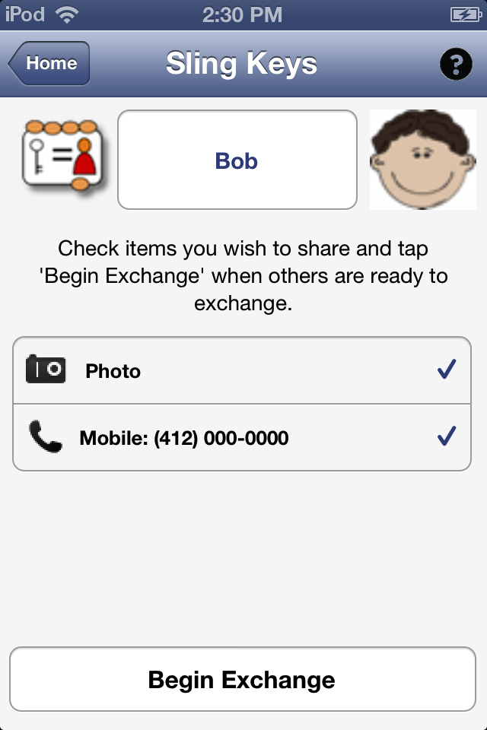
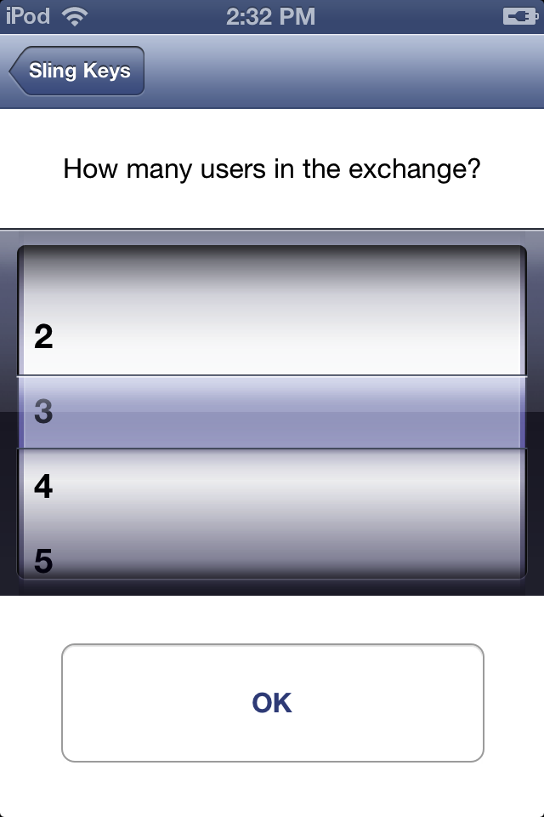
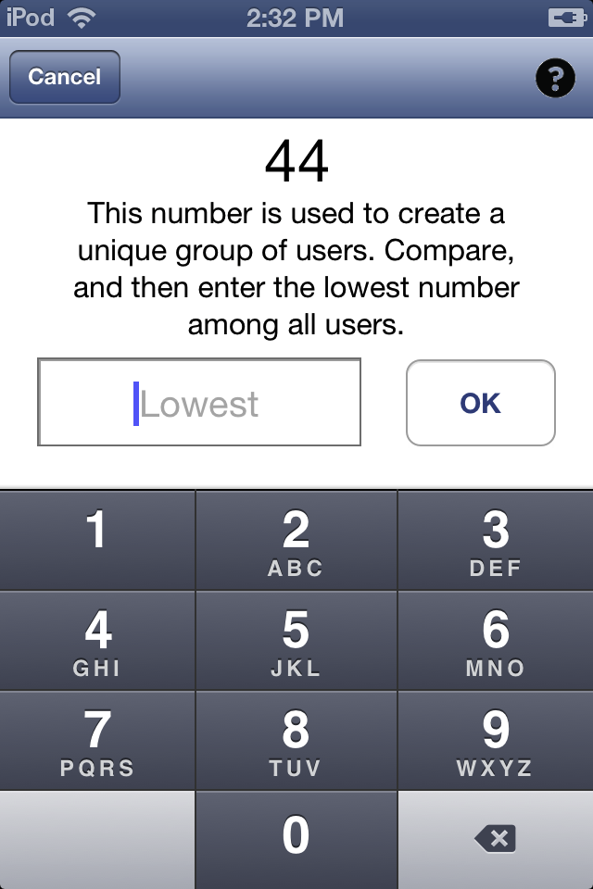
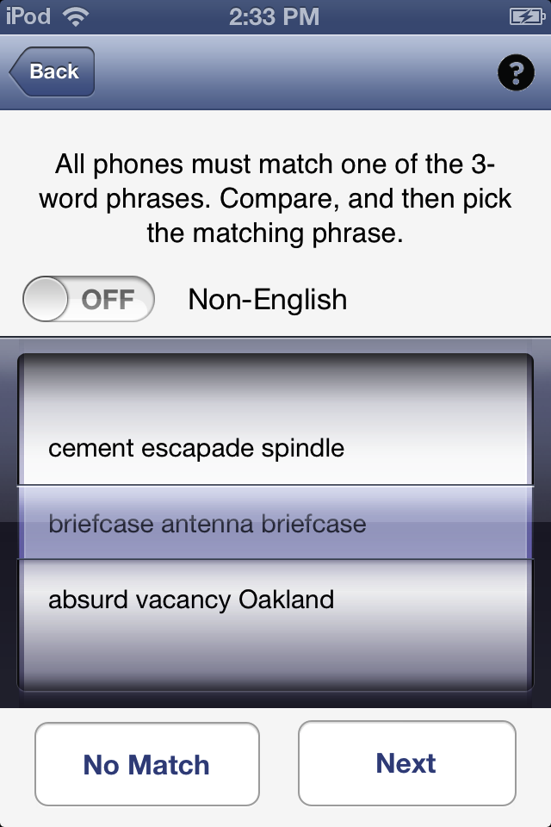
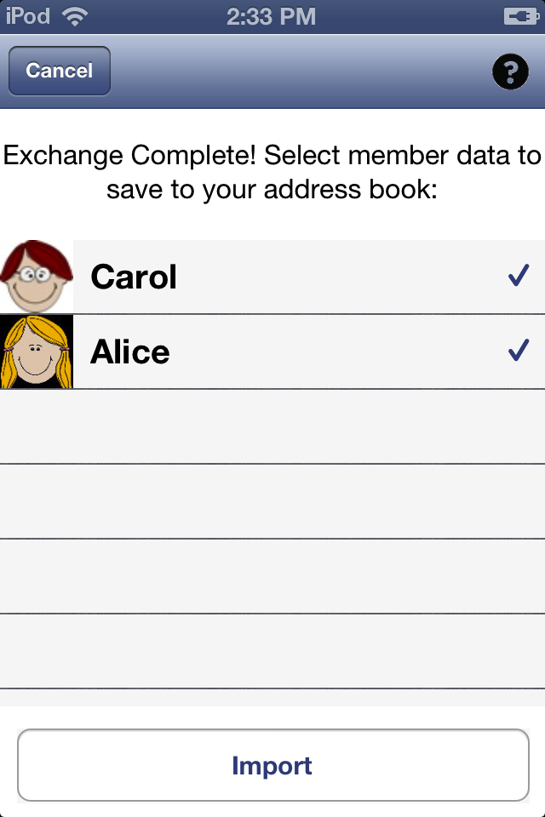
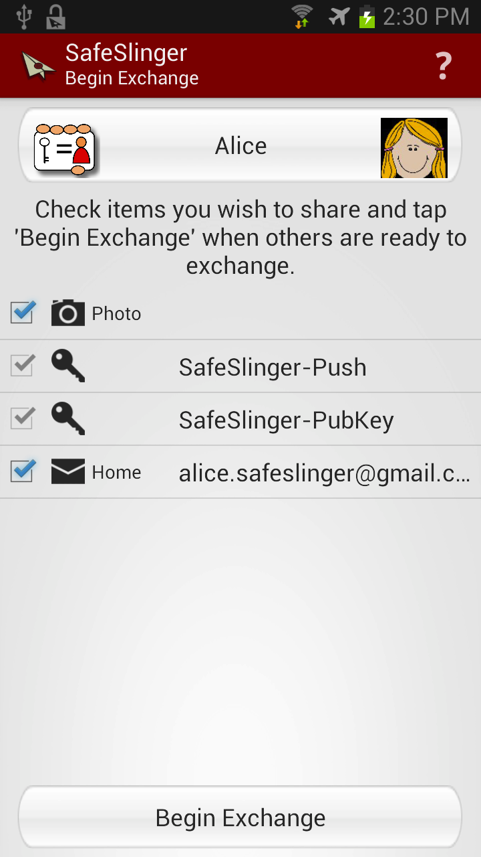
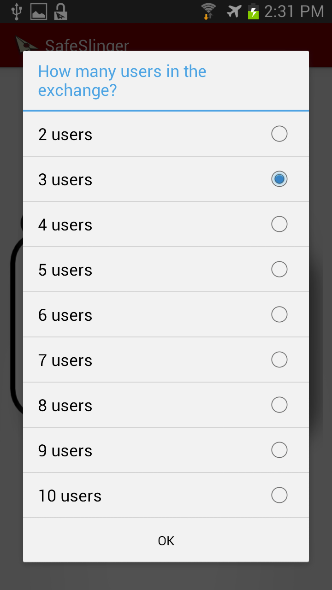
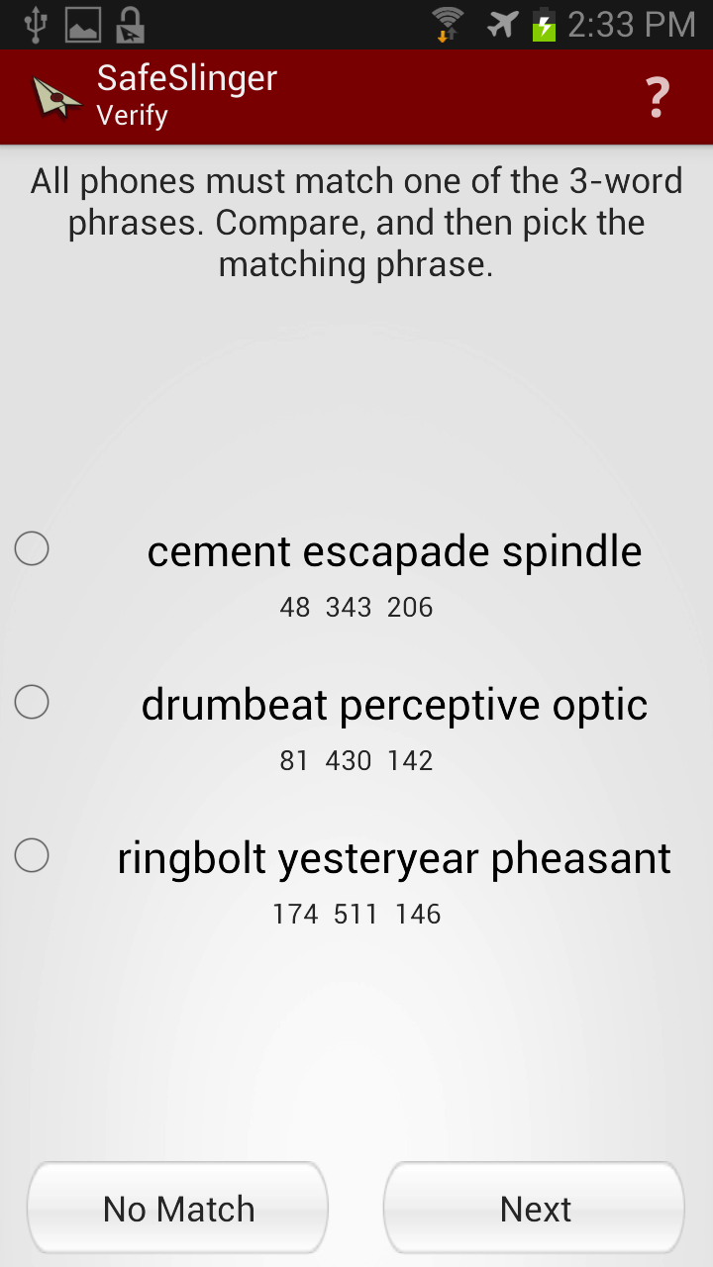
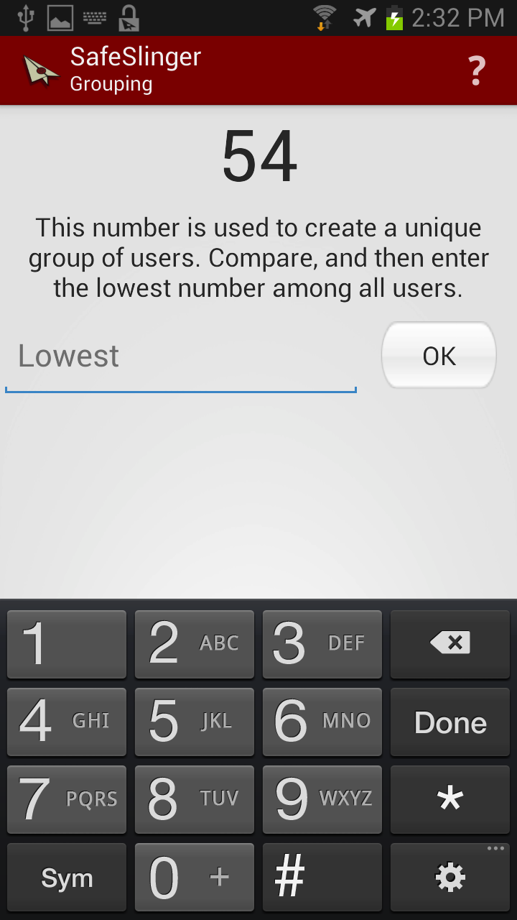
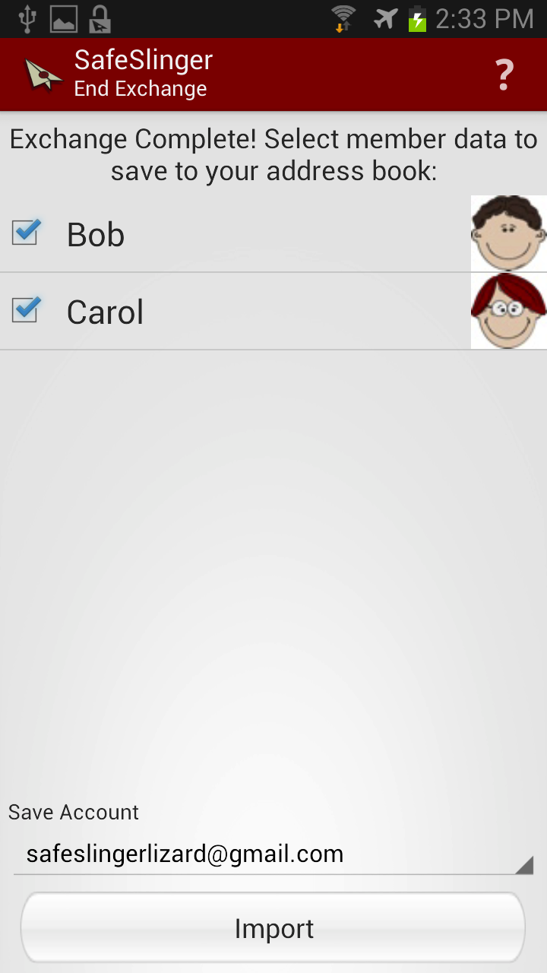
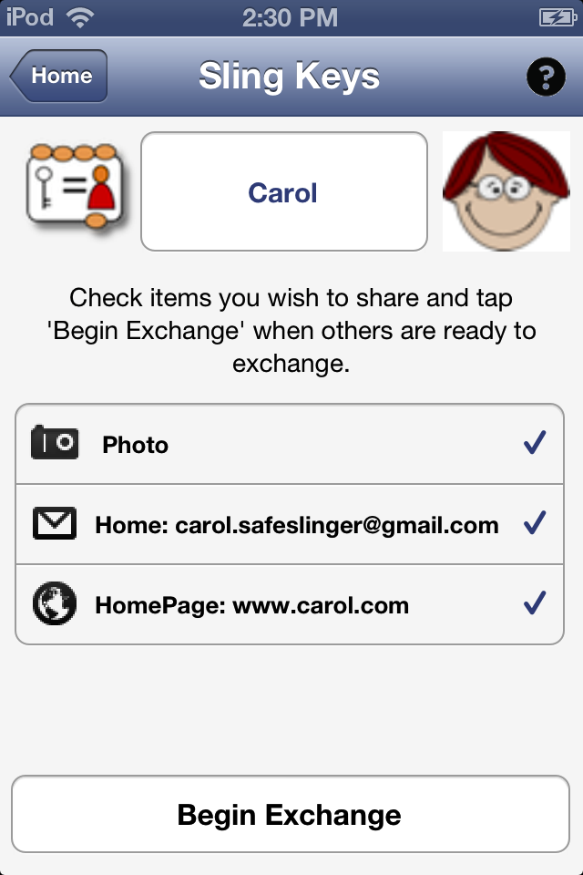
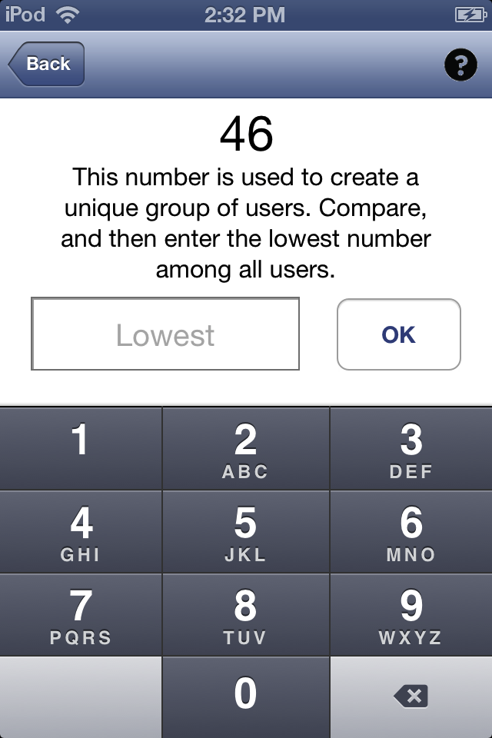
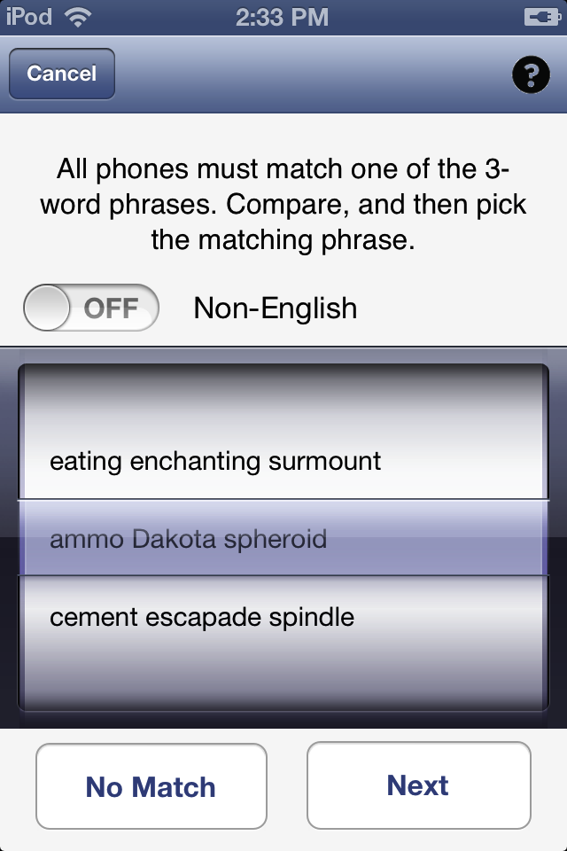
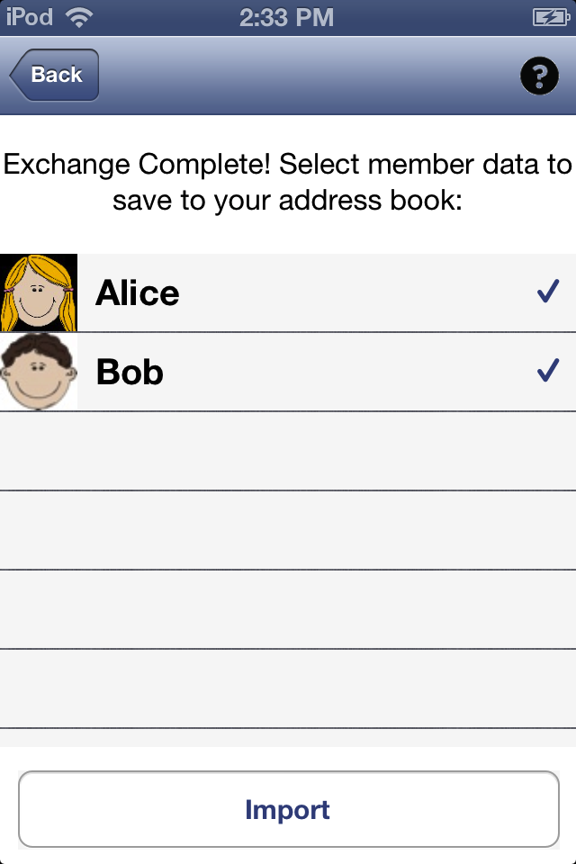
Simple User Interactions
44
3
…
Bob
54
…
Easy to use! Each user requires 1 number comparison, 1 word phrase comparison
46
Alice
3
…
3
Carol

Slide 12
Challenge 1: Private Information Leak
Server learns contact information of all users
Approach
STR protocol¹ used to create a shared secret key under which all information is encrypted
Only if all verifications succeed, decryption key is disclosed to intended individuals
1. Y. Kim, A. Perrig, and G. Tsudik. Group key agreement efficient in communication, IEEE Transactions on Computers, 53(7):905–921, July 2004.

Slide 13
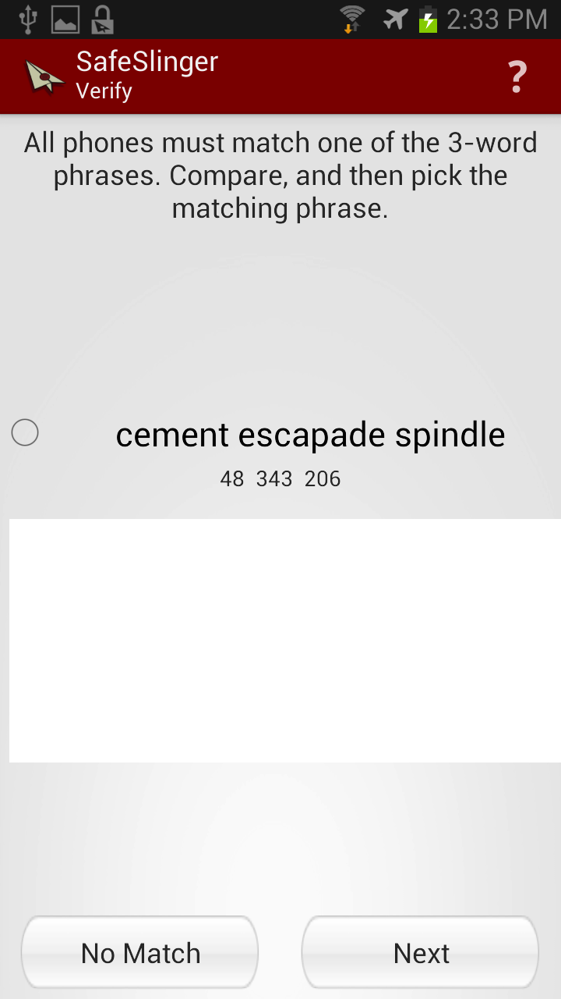
Challenge 2: Prevent Dialog Failure
Users simply click “Next” without checking phrases
Approach: Make users pay attention!
User has to pay
attention and
select matching
phrase!
Notes:
Each 3-word phrase contains 24 bits entropy (each word is selected form a word back containing 256 words, Zimmermann’s words)
During authenticity verification, each user has to compare literature phrase and make a decision, Match or No Match
However, people are lazy.
If users only simply click Next without checking, makes the protocol insecure
We design user interface to enforce users to compare phrase by adding two decoy phrases.
User has to pay attention; random selection only makes the protocol failure with a high chance

Slide 14
Challenge 3: No Information Revealed on Protocol Failure
When protocol fails, no user information is revealed to anyone else
All-or-nothing property
Approach: Commitment tree with several commitment stages

Slide 15
Commitment Tree
Nonce_{M}
{Nonce_{M}}_{DH Key}_
HN_{M}
Nonce_{E}
Creation
HN’_{M}
HN_{E}
Usage
{Data}_{NonceM}
Hash_{D}
DH Key⁺
Commitment
“→” indicates Cryptographic Hash Function (SHA3)
“{x}_{K}” represents encryption with key K
Notes:
The commitment tree is computed by collision resistance cryptographic hash by each smartphone and reserved for later verification.
Commitment tree is constructing with encrypted contact data, public parameter for group DH, and two branches of random nonce presenting positive/negative decision where a user made
During authenticity verification, user could decide to release red part, negative decision (decoy or no match) or blue part, positive decision (match phrase).
Once each user collects all other decision in a group, he can compute shared secret by running STR; the secret is used to protect decryption key, NonceM, and distribute it to other user such all they users can decrypt
The encrypted contact in the beginning.
%To open the commitment, pair of inputs need to be disclosed.
%Collision-resistance ensures it is computationally infeasible to find another pairs to result the same commitment

Slide 16
Challenge 4: GitM Attack
Malicious group member performs Group-in-the-Middle (GitM) attack
Approach
Users enter number of participants
All users compare word list with other users (word list simplifies comparison)
Commitment tree makes GitM attack a daring attack (success probability = 2⁻²⁴)
Notes:
Commitment tree design and authenticity verification through phrase comparison converts GitM from safe attack to daring attack.
Chance for GitM attacker equal randomly guessing 24 bits entropy to make collisions among users, resulting low probability to succeed, 2^-24

Slide 17
Evaluation
Goal: measure efficiency of contact exchange
User study settings
Baseline comparison with Bump
Recruited 24 users
Separate into groups: 2 (small), 4 (middle) and 8 (large)
Each group runs either Bump or SafeSlinger in random order to exchange contact information
Repeat exchanges multiple times

Slide 18
Performance Results
Notes:
Bump takes time in middle and large groups because:
Total interaction is around N^2 when there is N members in the group
Bump misclassified group (A bumps with B, and C bumps with D, but A will get vCard from C), resulting in lots protocol errors.

Slide 19
Summary
Maintains user privacy
Only group members learn exchanged information
Server does not learn information
Simple to use and resilient to user errors
Supports Rich Applications
Secure text and file messaging
Secure Introduction
Webpage: http://www.cylab.cmu.edu/safeslinger/
Apps are available on Apple Store/Google Play
Future work:
Open source to spur adoption for developers
Develop plugins for email and messenger clients

Slide 20
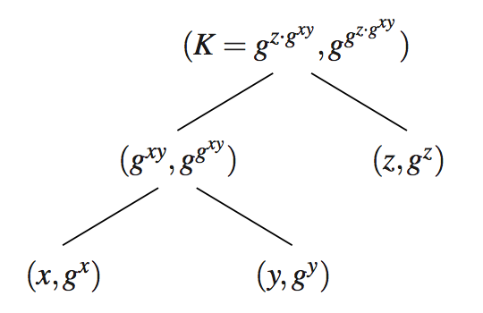
Backup: Group-Diffie-Hellman Key Agreement (STR)
*mod p is omitted to simplify description
Notation for each node: (private key, public key)
Notes:
User X,Y,Z

Slide 21
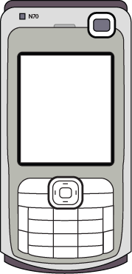





Related Work: SPATE [Lin et al. 2009] Small-group PKI-less Authenticated Trust Establishment
Efficient
Member performs 3 actions
Select data
Count group size
Compare
Simple comparison
Only 1 user needs to pay attention
Pearl
Amber
Indigo
Red
Violet
Jade
Notes:
Talk the leader selection
Mention visual comparison

Slide 22
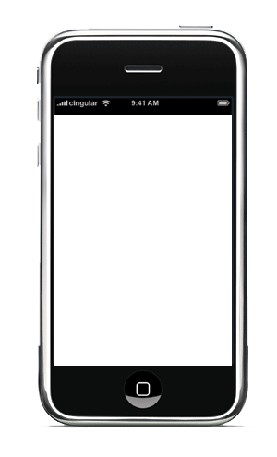
Verification
Count the number of people present
Compare the various checksums (T-Flag)
Notes:
T-Flags contains 8 blocks, each block could present 8 colors, total entropy is 24 bits

Slide 23
Issues in SPATE
T-Flag comparisons makes protocol secure if and only if users are diligent
All “Match” signatures: save data
“Error” or no signature: discard data
Dialog failure: Users click “OK” to continue
What if the slow user found a problem?
Execute locally (physically presented)
Notes:
Every clicks OK without comparison, the protocol will suffer MitM attacks
Slow user could not change the group decision, most of users still accept bogus data in the end of protocol.
If protocol fails, most of all users still get data by clicking OK to save the exchange information.
Therefore, information would leak even the protocol fails

Slide 24
Backup: SafeSlinger Protocol

Slide 25
SafeSlinger Protocol (con’t)

Slide 26
SafeSlinger Protocol

Slide 27
Probability Analysis for MitM
Phrases comparison converts the safe attack to the daring attack
Analyze MitM attack success probability based on user behavior
All users are lazy: randomly pick one phrase to continue
(1/3)^{n} when the group has n members
Unlikely to happen because decoy phrases makes the protocol aborts in high probability
Some users turns to be “partial diligent”

Slide 28
Partial Diligent Cases (1/2)
At least one word match (upper bound)
The first word exactly matches

Slide 29
Partial Diligent Cases (2/2)
The first and second words match P₃≤P((A₁=B₁)&(A₂=B₂))=P₂*(1/256)=1.525878e-5
Whole phrase matches (diligent user) P₄≤P((A₁=B₁)&(A₂=B₂) &(A₃=B₃))=P₃*(1/255) =5.98383885e-8

Slide 30
Comparison: SafeSlinger v.s. Bump
 | SafeSlinger | Bump
Scalability (# users) | 2-10 | 2
Exchange Method | Local/Remote | Physical
Privacy | Only IP address | IP Address, Location, Accelerometer information
Security | High | Low
Device Requirement | Internet | Internet, Accelerometer
Additional feature | Built-in secure messaging | Fun to use

